Slide 1

Sortify App Prototype
AI-powered waste identification & disposal guidance
SOFTWARE ENGINEERING PROTOTYPE
PAGE 01

Slide 2
SORTIFY MOBILE APP
INTRODUCTION
Why Sortify, and what the prototype is designed to demonstrate
PROBLEM
PROJECT GOAL
Disposal routes for everyday items are often unclear.
Guidelines are fragmented, making correct segregation harder.
Rules can depend on waste category and location.
Move users from an unidentified item to actionable disposal instructions.
Combine identification, disposal guidance, history, feedback and supporting tools.
Demonstrate the core user-facing experience at prototype stage.
PROTOTYPE SCOPE
Local mobile demo with simulated predictions; no deployed backend or trained image-classification model yet.
SOFTWARE ENGINEERING PROTOTYPE
PAGE 02

Slide 3
SORTIFY MOBILE APP
METHODOLOGY
Prototype architecture, functional flow and implementation stack
FLOW
ARCHITECTURE
TECH STACK
Capture / upload image
Validate image
Simulate prediction + confidence
Retrieve category & disposal guidance
Save, sort, ask assistant or give feedback
Mobile-first React Native app
Local waste knowledge/catalog
Local history, profile & feedback
Location-aware guidance text
Demo admin workflow
Expo / React Native
TypeScript
Expo Router
Expo Image Picker
AsyncStorage for local persistence
CURRENT BOUNDARY
Frontend/local demo only — no FastAPI, PostgreSQL, trained ML model or live LLM is connected.
SOFTWARE ENGINEERING PROTOTYPE
PAGE 03

Slide 4
SORTIFY MOBILE APP
RESULTS & EVALUATION
What is working now, and what remains for the next stage
IMPLEMENTED
NOT YET IMPLEMENTED
Mobile UI and routed navigation
Searchable/filterable waste guide
Scan demo with image validation + confidence states
Disposal steps, cautions and local guidance
History, activity, profile and feedback
Scripted catalog-based assistant + admin demo
Trained image-classification model and real inference
FastAPI backend + PostgreSQL database
Production authentication
Live location/collection-point services
Live conversational AI backend
EVALUATION
Functional evaluation only; ML metrics require a trained model + held-out test set.
SOFTWARE ENGINEERING PROTOTYPE
PAGE 04

Slide 5
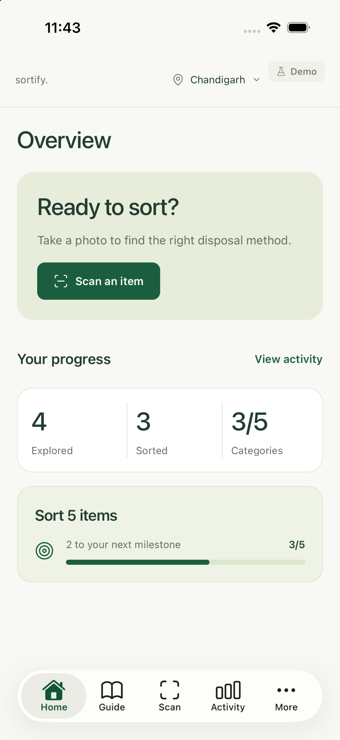
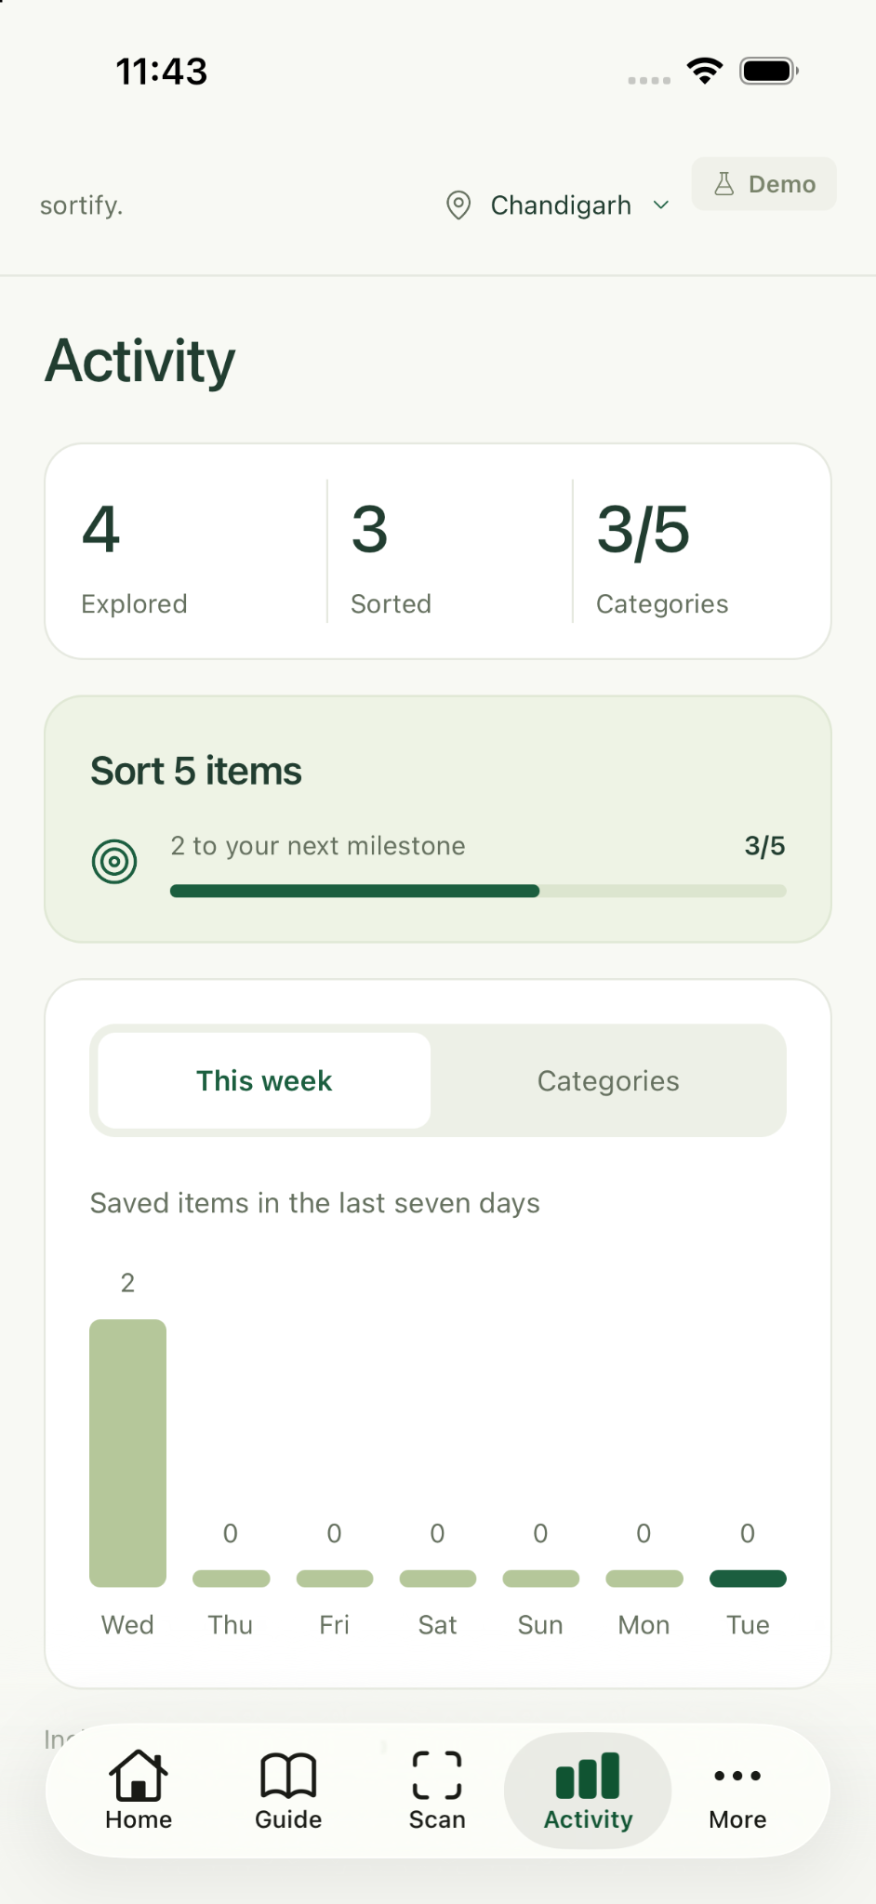
SORTIFY MOBILE APP
Home & Activity Page
Fragmented Guidelin
Disposal guidelines are split across varius municipal websites and physical flyers, requiring slow and tedious manual searches.
SOFTWARE ENGINEERING PROTOTYPE
PAGE 05

Slide 6
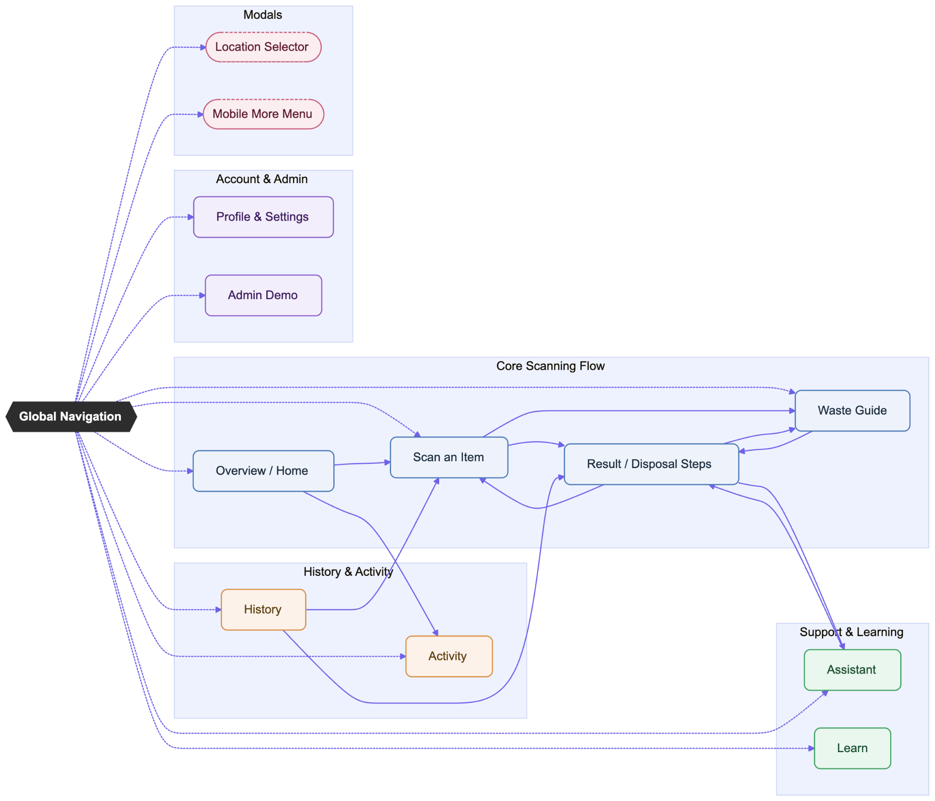
SORTIFY MOBILE APP
APP-FLOW DIAGRAM
Fragmented Guidelin
Disposal guidelines are split across varius municipal websites and physical flyers, requiring slow and tedious manual searches.
SOFTWARE ENGINEERING PROTOTYPE
PAGE 06

Slide 7

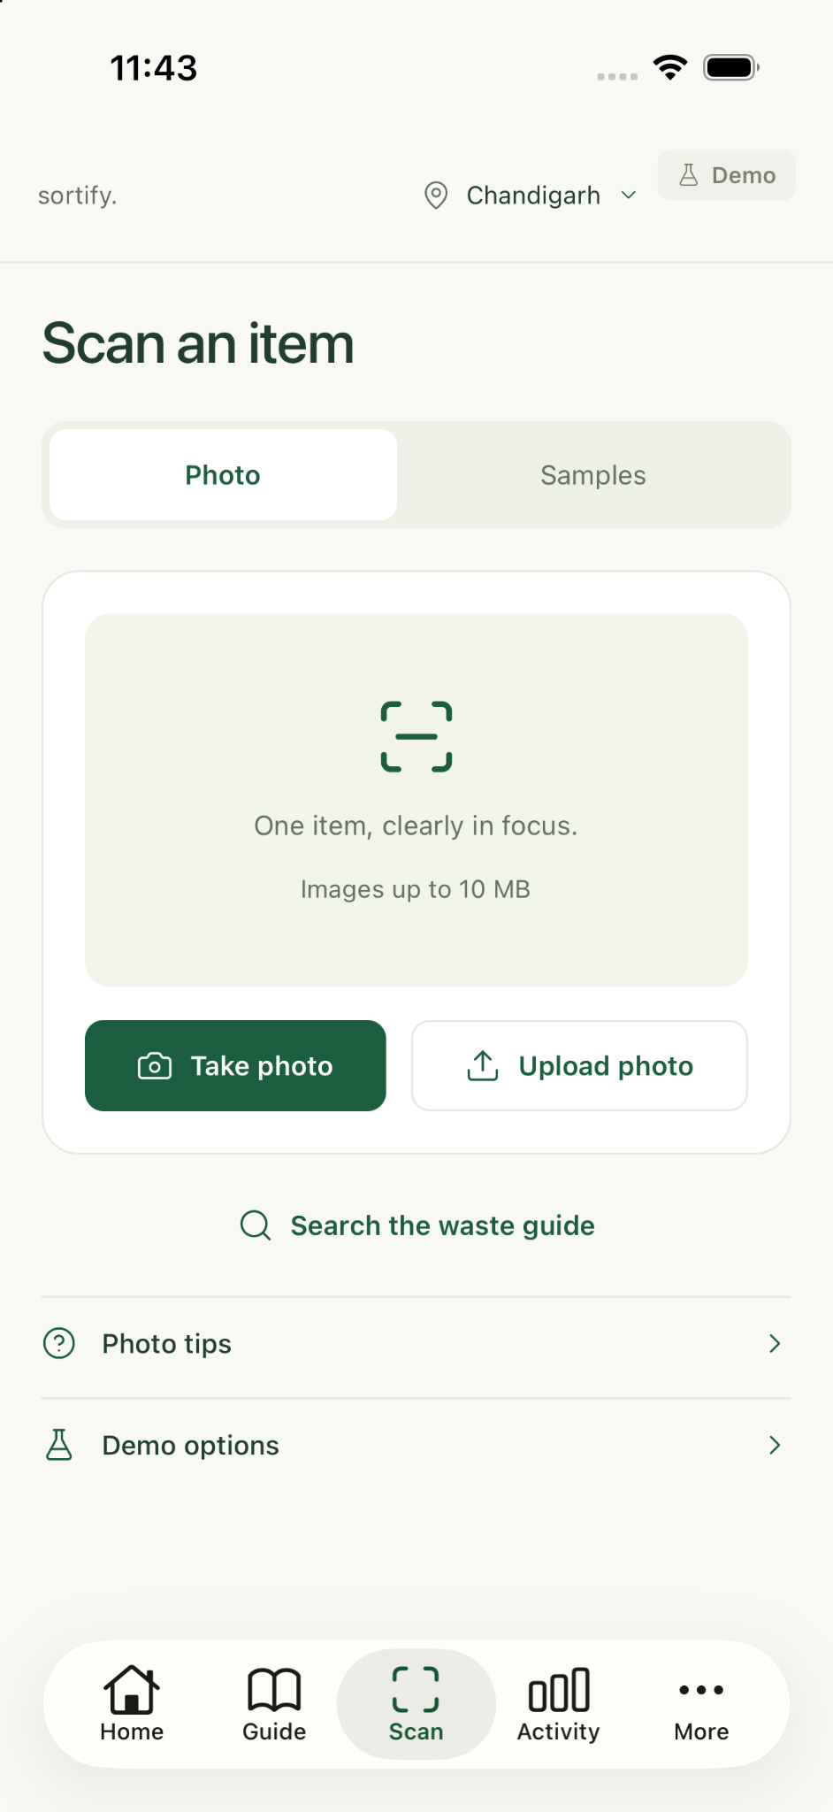
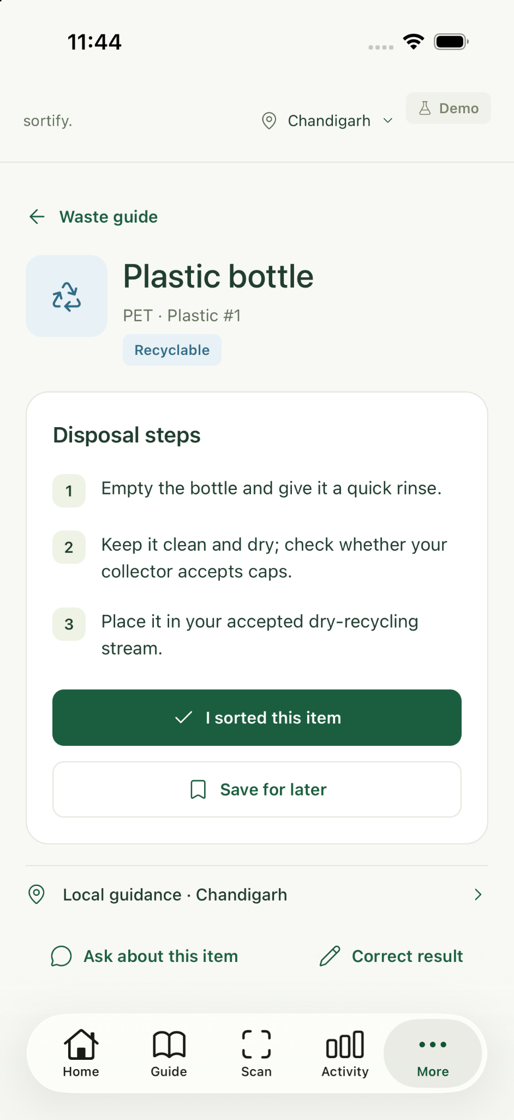
SORTIFY MOBILE APP
WASTE IDENTIFICATION & DISPOSAL GUIDANCE
1. IMAGE CAPTURE & UPLOAD
2. DISPOSAL GUIDANCE
SOFTWARE ENGINEERING PROTOTYPE
PAGE 07

Slide 8
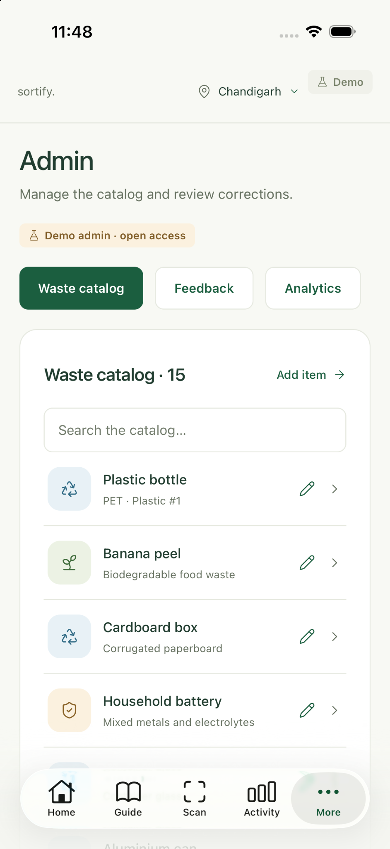
SORTIFY MOBILE APP
Admin Dashboard
Fragmented Guidelin
Disposal guidelines are split across varius municipal websites and physical flyers, requiring slow and tedious manual searches.
SOFTWARE ENGINEERING PROTOTYPE
PAGE 08

